Slide 1
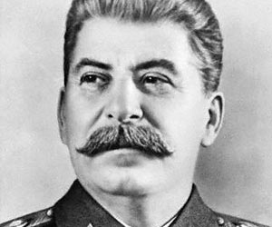
Joseph Stalin Human Rights Violations

Slide 2
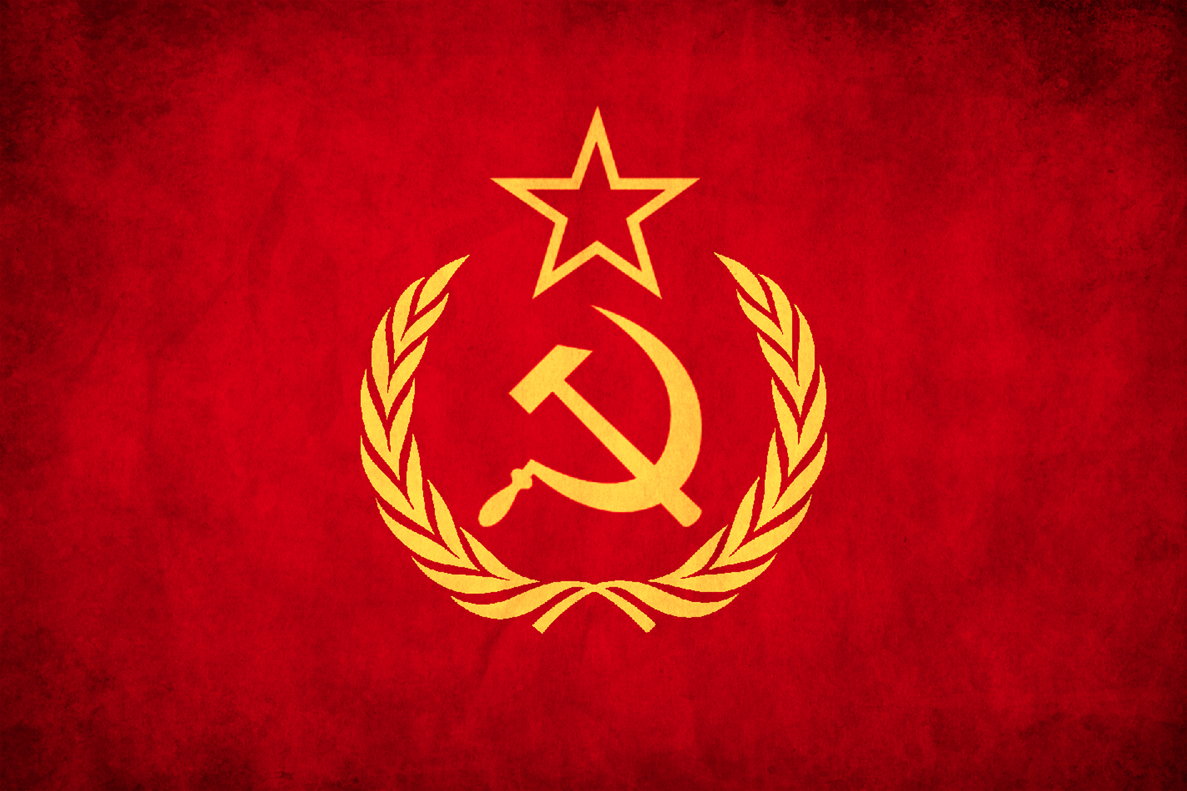
Why?
Nothing Personal
He wanted all power to belong to soviet Russia
Took out anyone in his path

Slide 3
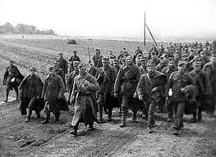
Article 5
No one shall be subjected to cruel, inhuman or degrading treatment or punishment.
took 300, 000 Polish prisoners
Killed 25, 700 POW

Slide 4
Article 13
Everyone has the right to freedom of movement and residence within the borders of each state
Millions forced off holdings on to collective farms
Major landowners, killed

Slide 5
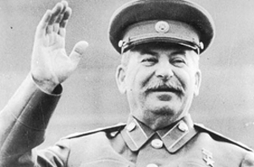
Article 20
Everyone has the right to freedom of peaceful assembly and association
No one may be compelled to belong to an association
Not USSR? Not a problem

Slide 6
Article 25
Everyone has the right to a standard of living adequate for the health and well-being of himself and of his family, including food, clothing, housing and medical care…
Destroyed infrastructure and food supplies so Germans, and others could not take them

Slide 7
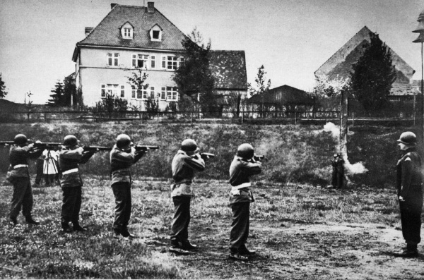
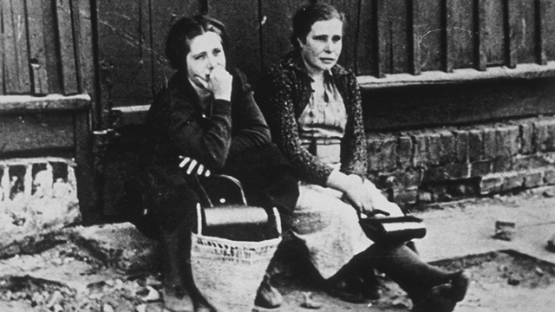
More Than Just Human Rights
Shot deserters
Soviet troops raped 10, 00 to 2 million women
Killed Polish Officers, blamed Germans

